Slide 1



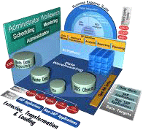
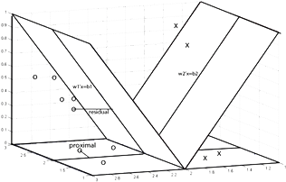
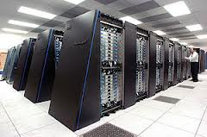
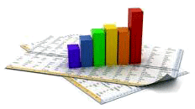

Week - 01
Introduction to Data Mining
Taufik Sutanto

Slide 2
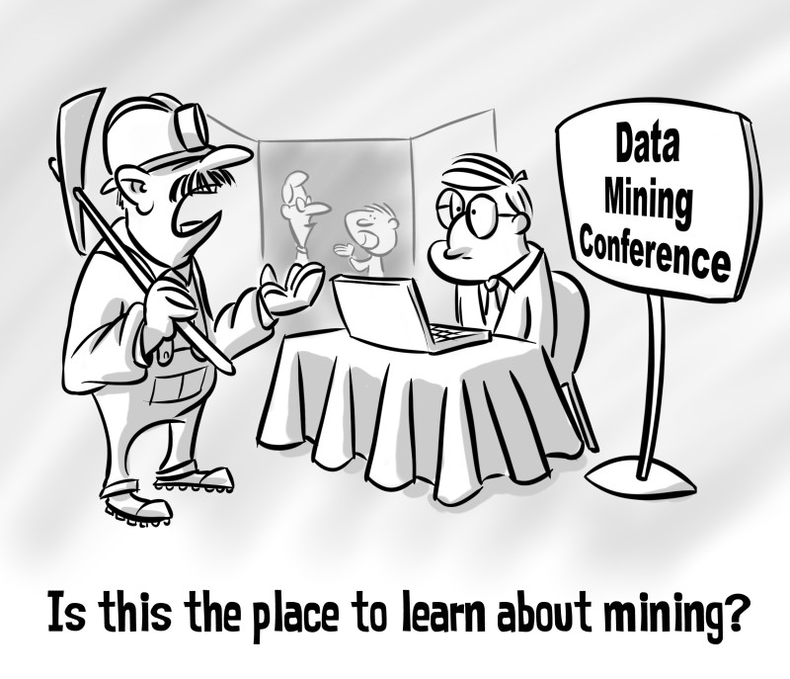
Data Mining
http://cadeh.com/portfolio/mining/

Slide 3

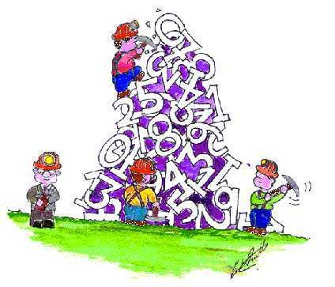
What is DATA MINING?
http://courses.essex.ac.uk/ce/ce802/Data%20Mining%20Cartoon.jpg

Slide 4
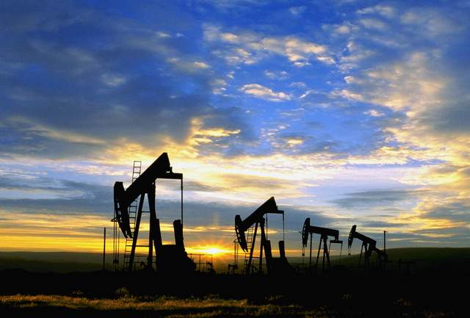



Industri 4.0 = DATA
Data is the new oil. Like crude oil, data is valuable, but if it is not managed properly, it cannot be utilized..
– Clive Humby, DunnHumby
For the first time, we have an economy based on a primary resource (information) that is not only renewable but also continuously growing.
– John Naisbitt
Notes:
Oil vs Data
4

Slide 5








Limitless Potential for Creativity & Innovation in the Digital Era.
"Large accommodation companies do not own their own hotels.“
"Large transportation companies do not own their own fleets."

Slide 6
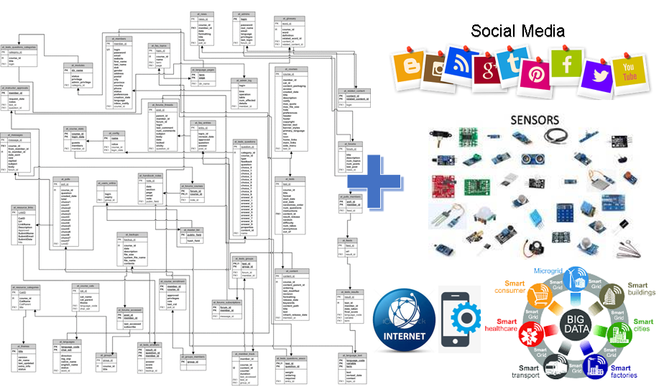
Data is Rapidly Growing

Slide 7
Data Mining Definition
There is no universally agreed-upon definition; however, here are some examples of existing definitions:
- Data mining is the search and analysis of large data sets to discover meaningful patterns and rules (Berry & Linoff, 2004: 7).
- Data mining is a technique for analyzing large sets of data to find unexpected and useful relationships for the data owner (Hand, 2001: 1).
- Data mining is the process of discovering patterns and relationships within data (Hornick, 2007: 6).
- Data mining is an automatic or semi-automatic process for discovering new and potentially valuable information (knowledge) from a data set (Tang & Jamie, 2005: 2).

Slide 8
Definisi Data Mining?
Di Module ADM-01 di berikan contoh definisi formal dari beberapa literature. Beberapa komponen pentingnya adalah:
Pencarian non-trivial – Latent/Hidden pattern (pola di data).
Prosesnya iterative.
Dengan Business Understanding (domain Knowledge) disusun beberapa hipotesis di awal proses mining.
Actionable insight: Interpretasi > Akurasi.
Biasanya pada data observasi (database/datawarehouse) yang relative besar.

Slide 9
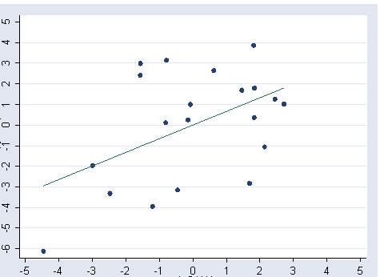
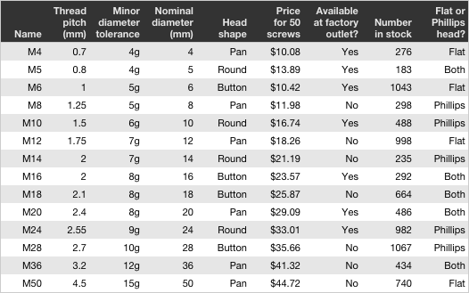
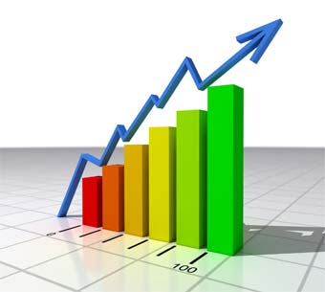
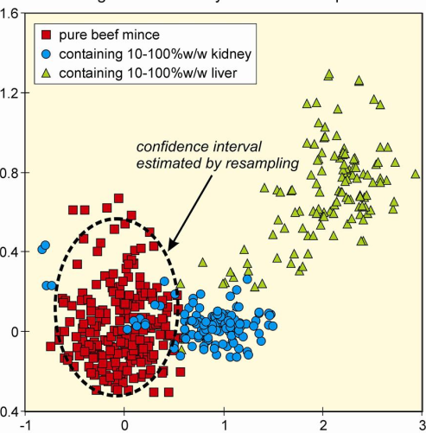
Statistic
“Simple”, but theoretically complex
Mengapa?

Slide 10
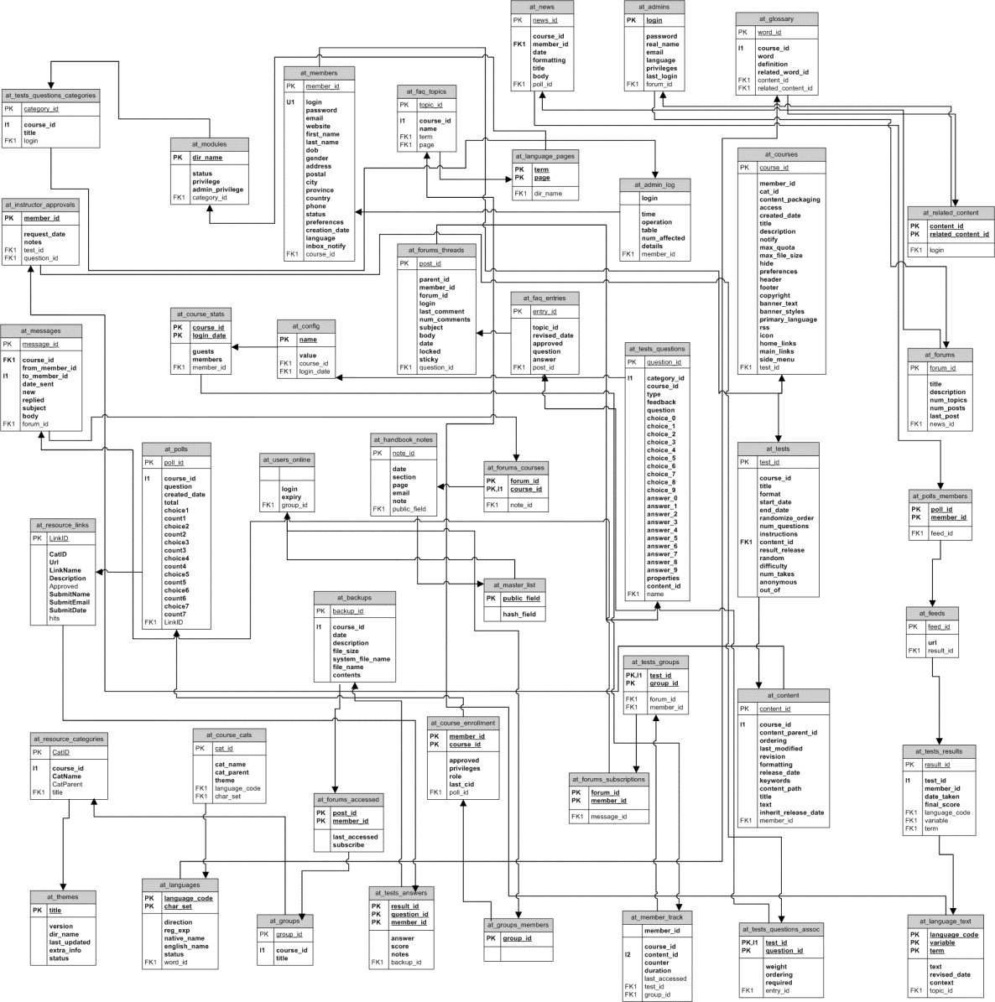



Data today

Slide 11
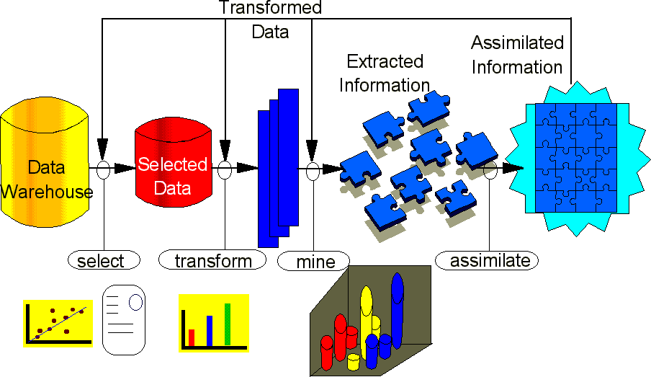
DATA MINING
“Complex”,
but theoretically simple, Mengapa?

Slide 12

DATA MINING

Slide 13
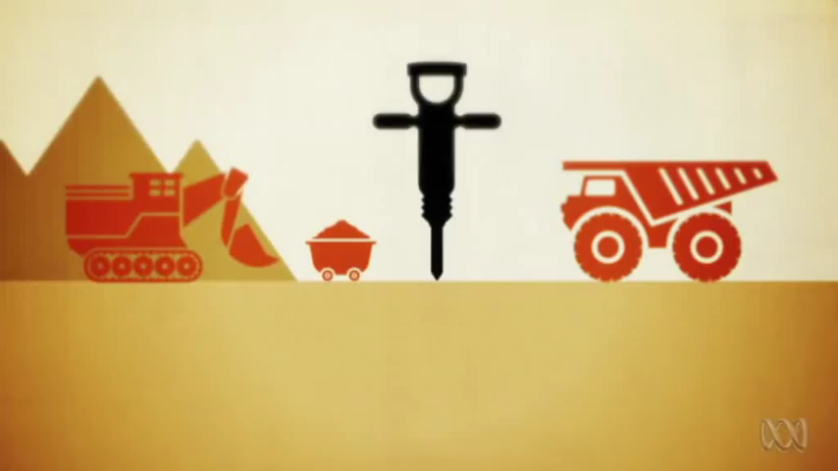
DATA MINING - Example

Slide 14


Data Mining VS The Rest
Statistics [1 h, 1 d]
Data Mining [n h, 1-n d]
Artificial Intelligence [mimicking human intelligence]
Machine Learning [⊂ A.I., 1 task]
Business Intelligence [dashboard, aggregate, query, slice-dice]
Business Analytics [adv. models]
6 Sigma/TQM [QC]
Quant
Data Science?

Slide 15
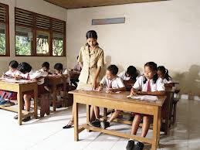

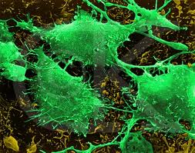
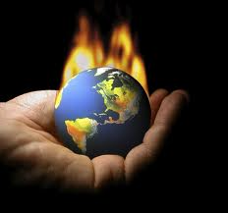
Data mining Applications
Rifkin, R, Mukherjee, S, Tamayo, P, Ramaswamy, S, Yeang, C-H, Angelo, M, Reich, M, Poggio, T, Lander, E, Golub, T & Mesirov, J 2003, 'An analytical method for multiclass molecular cancer classification', SIAM Review, vol 45, pp. 706-723.
Mustafa T, Sattar A & Khan M 2012, 'Data Mining Model for Higher Education System', European Journal of Scientific Research, vol 43, no. 1, pp. 24-29.
Olaiya F & Adeyemo AB 2012, 'Application of Data Mining Techniques in Weather Prediction and Climate Change Studies', I.J. Information Engineering and Electronic Business, 1, p. 51-59

Slide 16
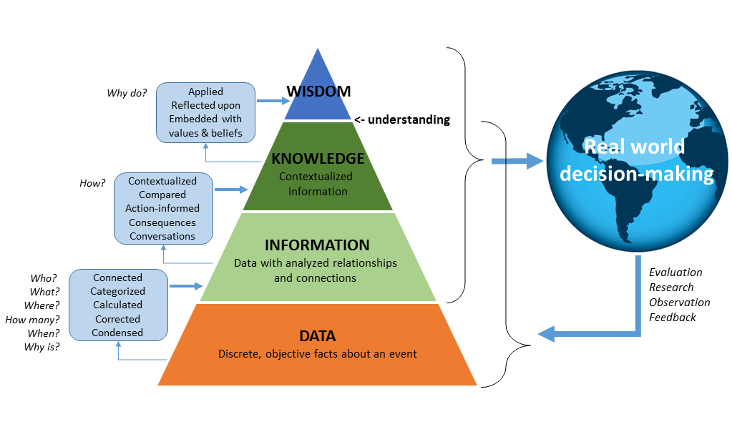
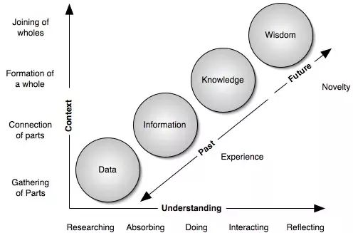
Data ➔ Information ➔ DIKW Pyramid
https://www.climate-eval.org/blog/answer-42-data-information-and-knowledge

Slide 17
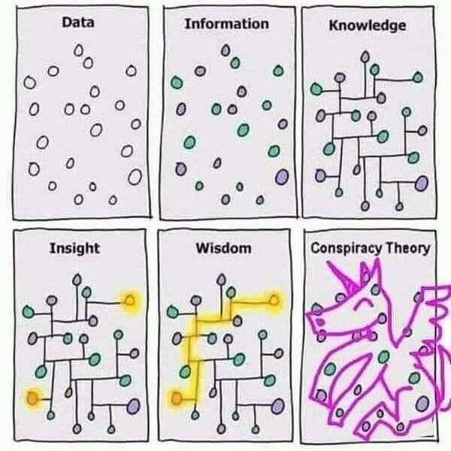
Insight?
Information helps us to observe what is happening, while insights explain why. These business insights help to arrive at decisions and define strategy.
Insights dive deeper into data and connect dots that may seem unrelated to shed light on the questions under consideration. treehousetechgroup.com

Slide 18
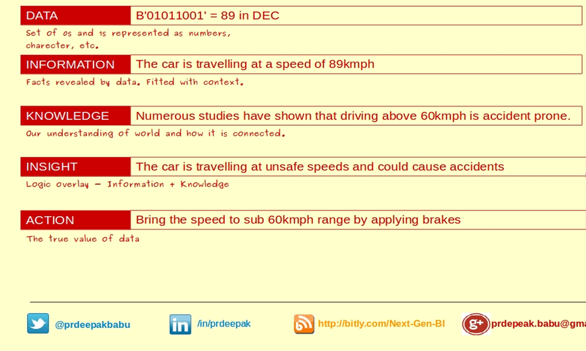
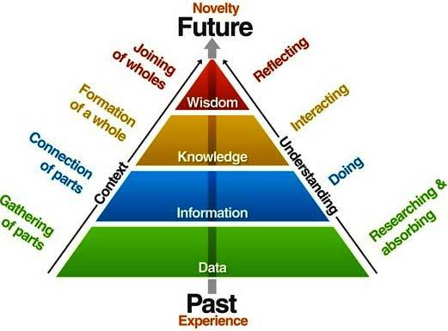
Data? Information? Insight?
Fakta, ukuran, kuantitas
Pemahaman mendalam akan suatu hal yang diamati.
Good Judgement & Action
https://kvaes.wordpress.com/2013/05/31/data-knowledge-information-wisdom/
Sebagian mendefinisikan sebagai “knowledge” dari data/Meaningful data
Informasi dikaitkan dengan pengetahuan teori/praktis

Slide 19
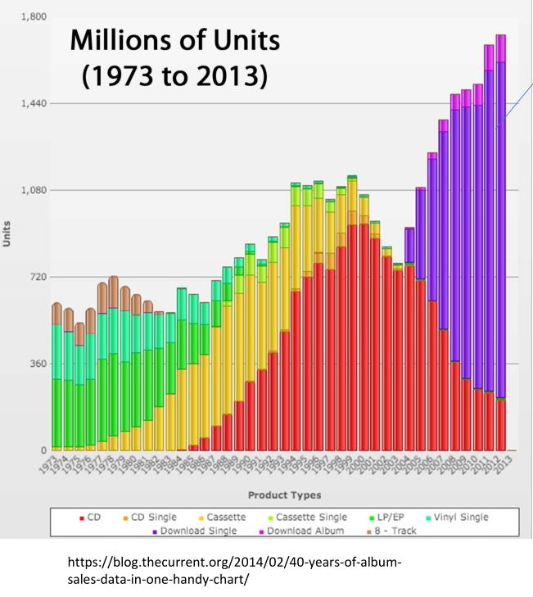
Data Mining & Decision Making

Slide 20
Thank You

